Slide 1

Quantum Computing with Qiskit : Phase I
Pawel Pratyush
Vrushali Shinde

Slide 2
Introduction
Quantum information software dev kit (SDK) by IBM Research in 2017.
Python library for simulating quantum computing at the level of circuits, pulses, and algorithms locally.
“IBM Quantum Experience” - Also provides cloud quantum computing facility to operate algorithms at IBM quantum computers.
Primary version uses Python.
A minimal version, Micro-Qiskit supports other platforms, however only has basic features.

Slide 3
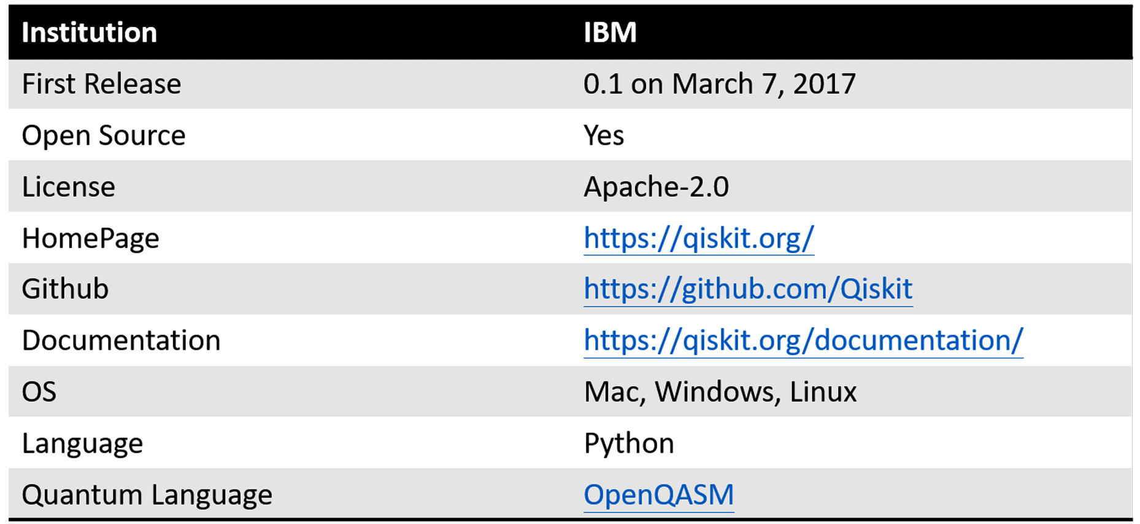
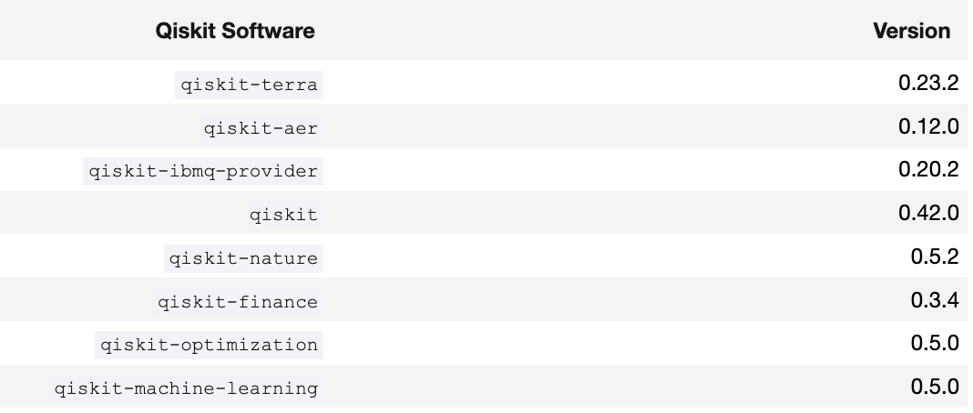
Overview

Slide 4
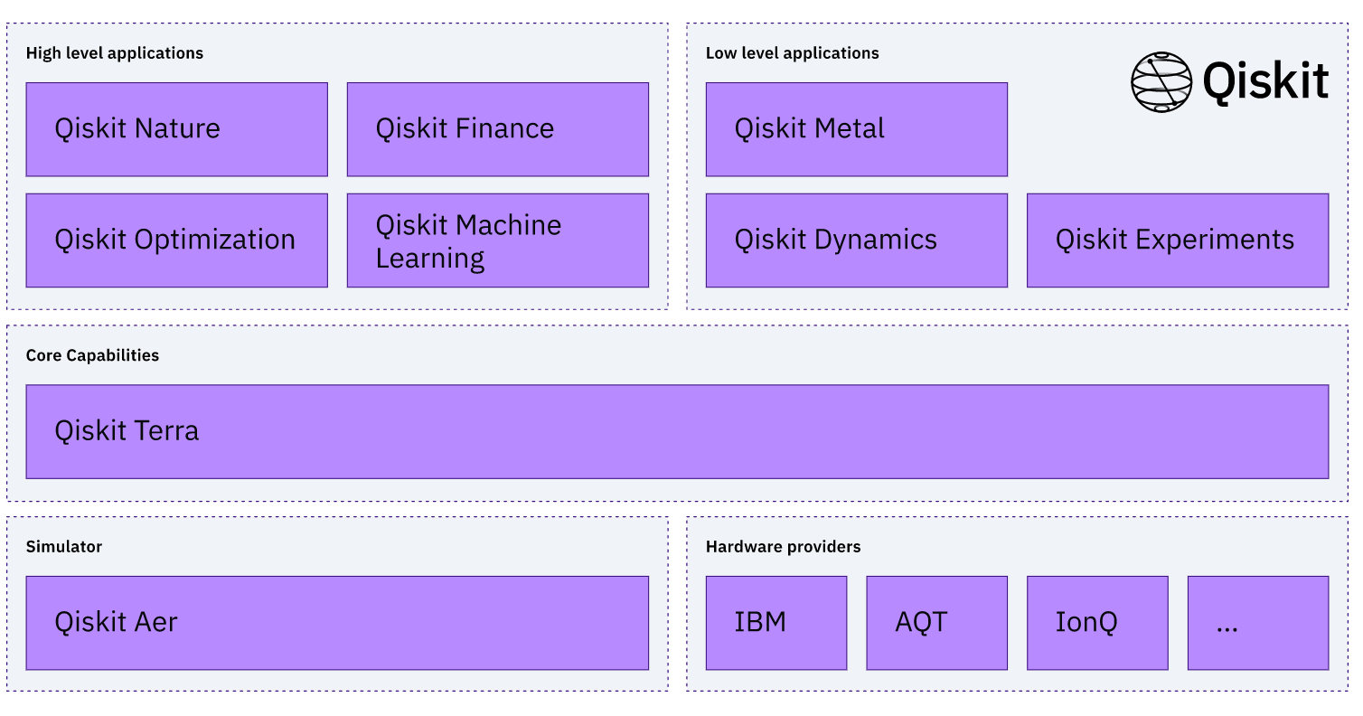
Components
Source: https://qiskit.org/documentation/

Slide 5
Qiskit Terra:
Provides a set of tools and libraries for working with quantum computers.
Designed to allow developers to build, test, and run quantum circuits on different backends, including simulators and real quantum devices.
Provides a variety of tools and interfaces for programming quantum algorithms and circuits, including a circuit composer, a quantum program builder, and a quantum register.
Provides tools for characterizing and mitigating errors in quantum circuits, An example of the circuit building will be shown in the tutorial part.

Slide 6
Simulator
QASM: simulates the behavior of quantum gates and circuits using classical algorithms.
State-vector: calculates the the state-vector of the output superposition of quantum gates in matrix form.
Unitary: simulate the behavior of quantum circuits by computing the unitary matrix of the circuit.
Aer: includes various backends, including QASM, state-vector, and unitary simulators, and supports parallel processing for faster simulation

Slide 7
IDE
Three options to build a circuit:
Local computer
IBM Quantum Experience (Cloud)
IBM Quantum Composer (GUI)

Slide 8

Local Computer:
Step 1: Search web for “Anaconda python distribution” (Make sure you are downloading 3.x version of python for qiskit)
https://www.anaconda.com/

Slide 9
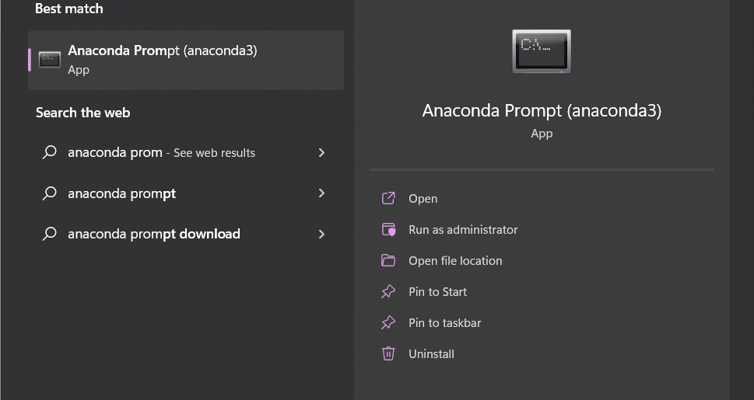
Step 2: After installing, run the installer and then search for anaconda prompt

Slide 10
Step 3: In prompt enter pip install qiskit[visualization] note: not to worry about red msgs as we can ignore them
Step 4: After successful installation we can close the prompt and search for anaconda navigator in search bar to launch Jupyter Notebook (Preferred one) / Spyder
Note: We are installing here qiskit in base environment. It’s a good practice to create a virtual environment to separate out the qiskit from other project.

Slide 11
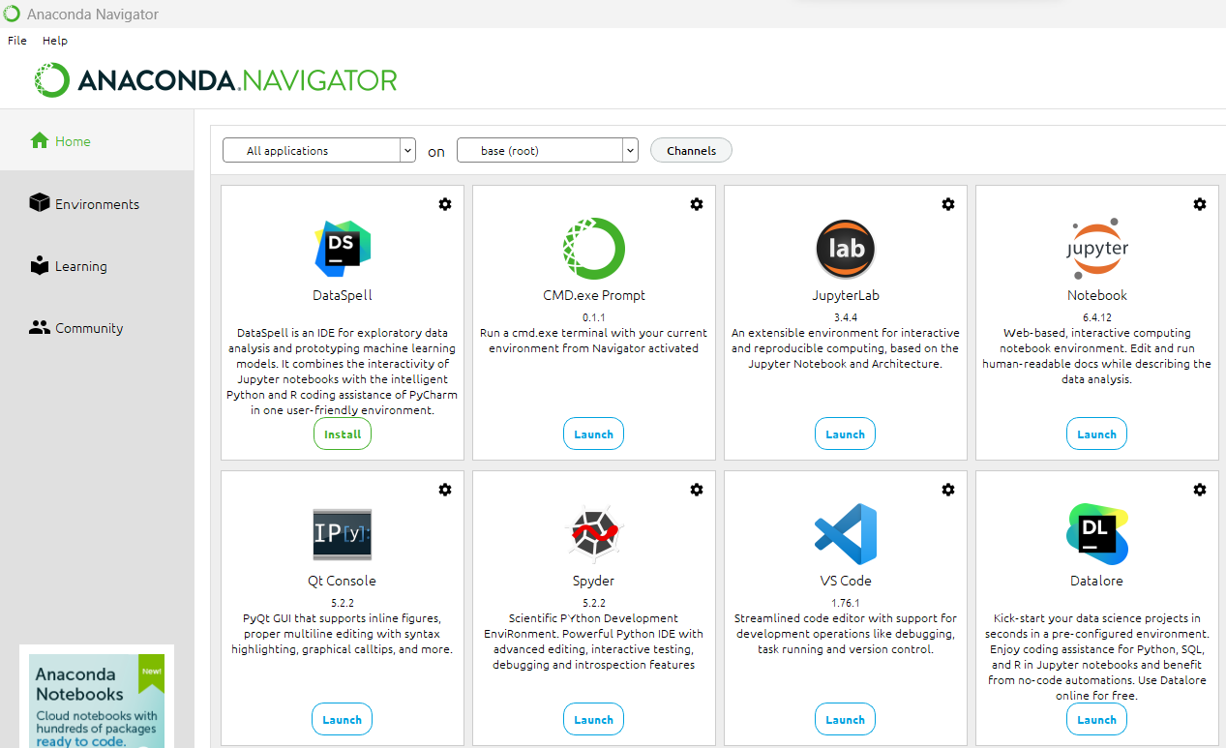
Anaconda Navigator

Slide 12
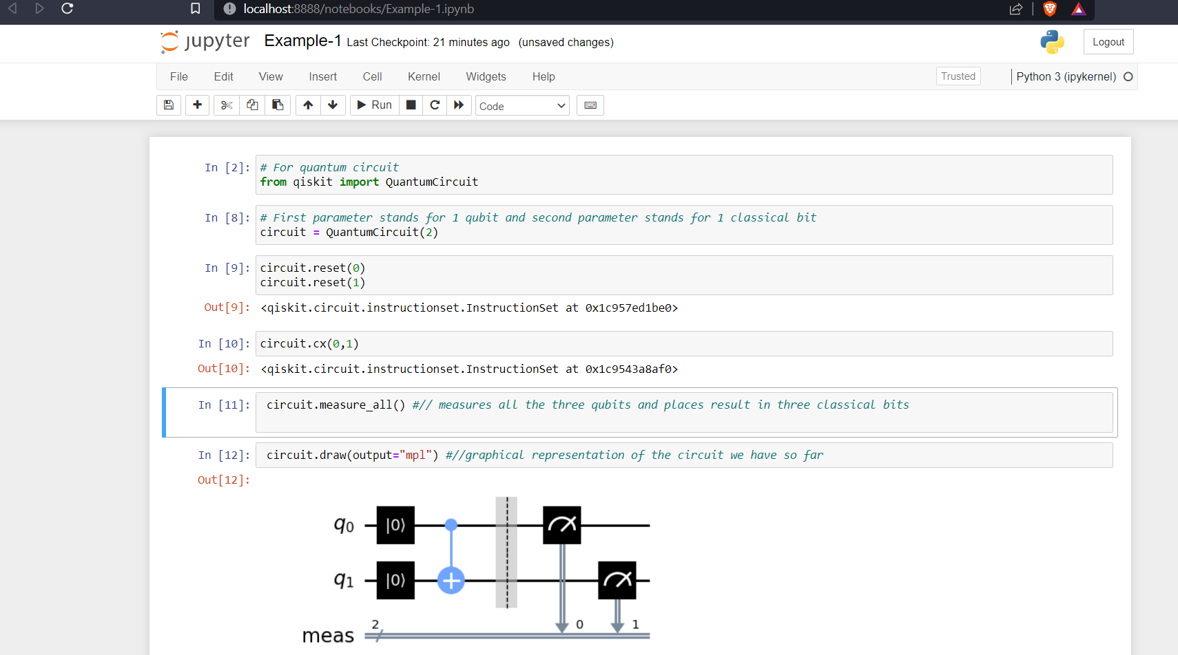
Run Qiskit locally

Slide 13
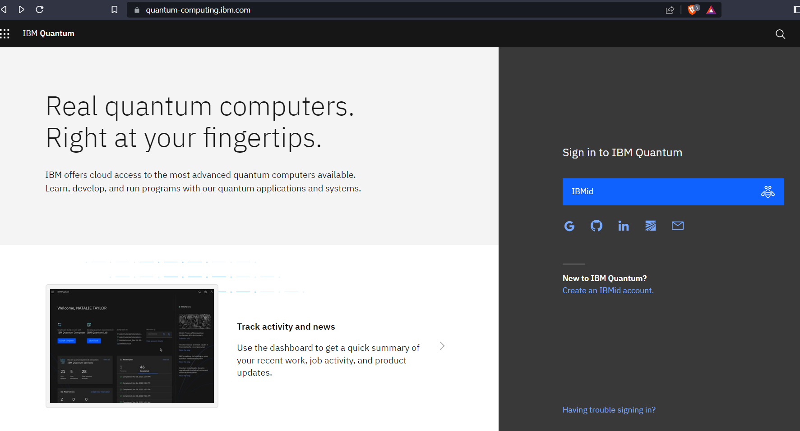
2. IBM Quantum Experience (Cloud):
Step 1: Create an account

Slide 14
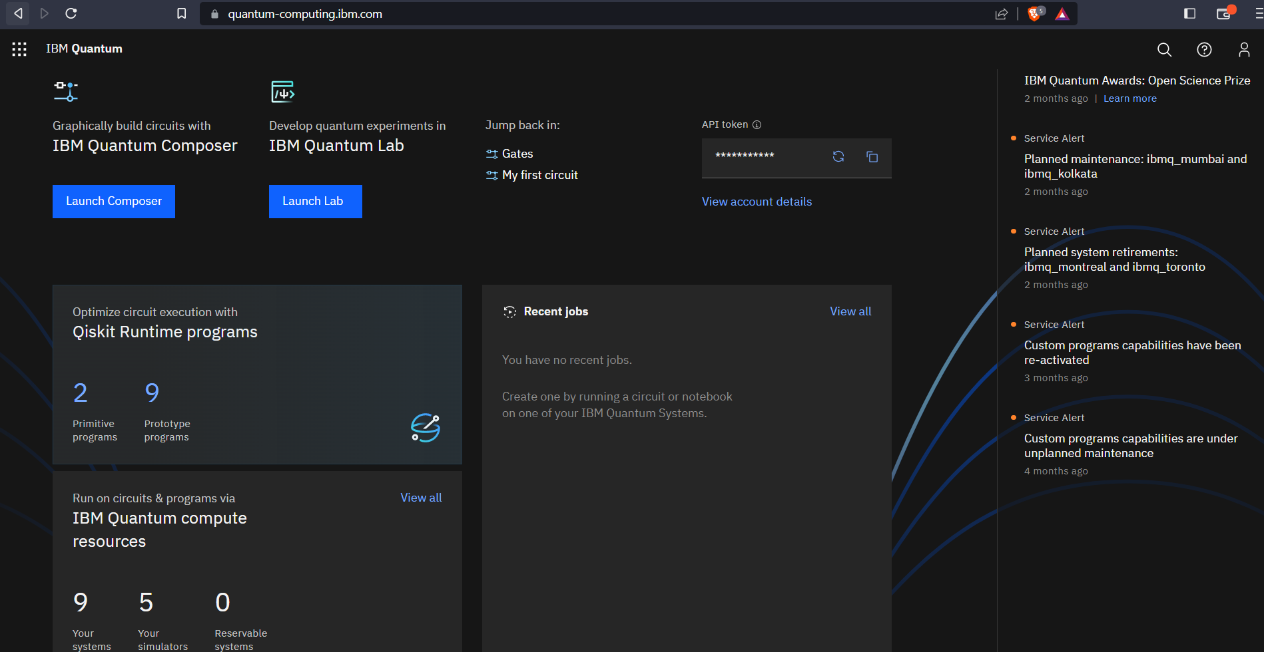
Step 2: After signing up to ibm quantum, you will have to save your token for future use. The token is visible on home screen. But if not we can retrieve it from the main menu.

Slide 15
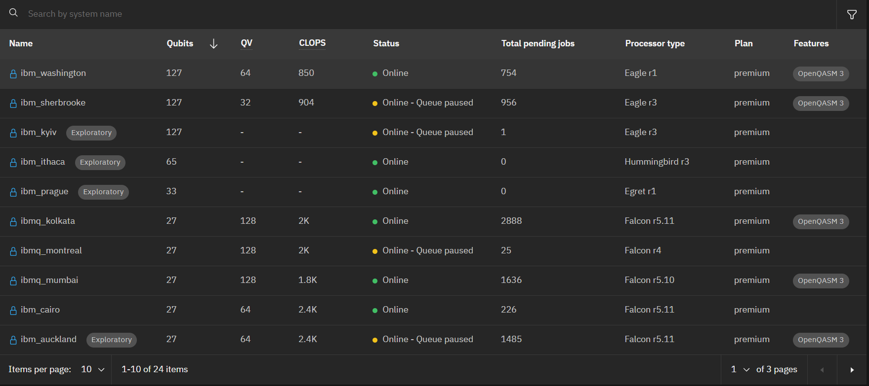
Available Compute Resources:

Slide 16
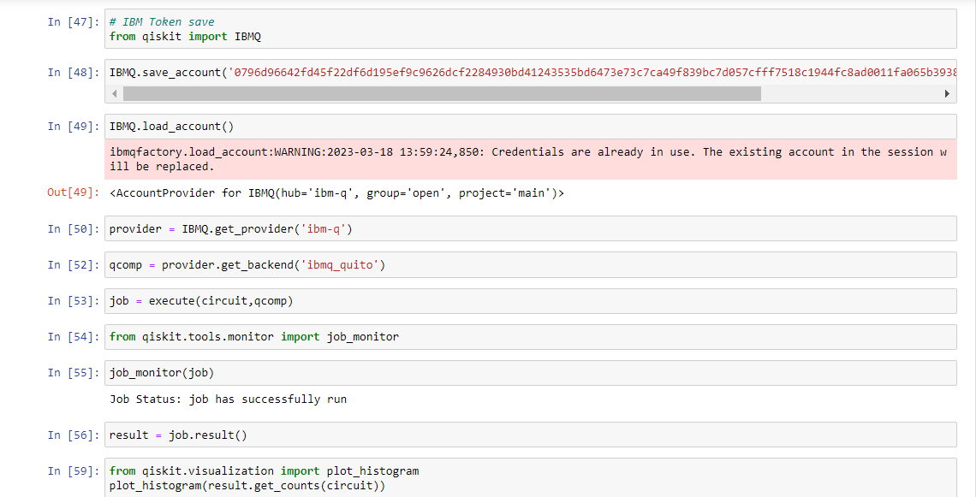
IBM API Token
The IBM Quantum Token is required to manage access to IBM Quantum cloud-based quantum computing resources in a fair and efficient manner, while ensuring that the system can respond to fluctuations in demand.

Slide 17
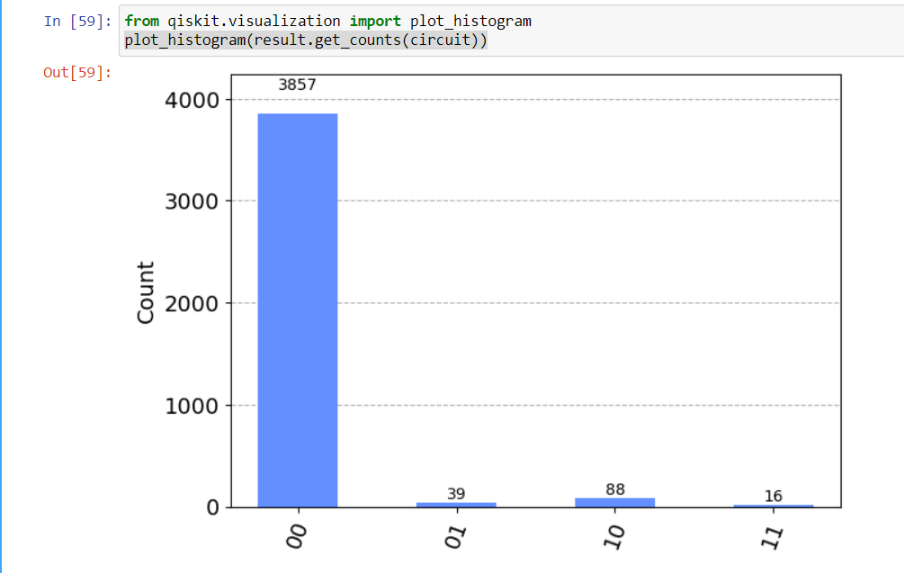
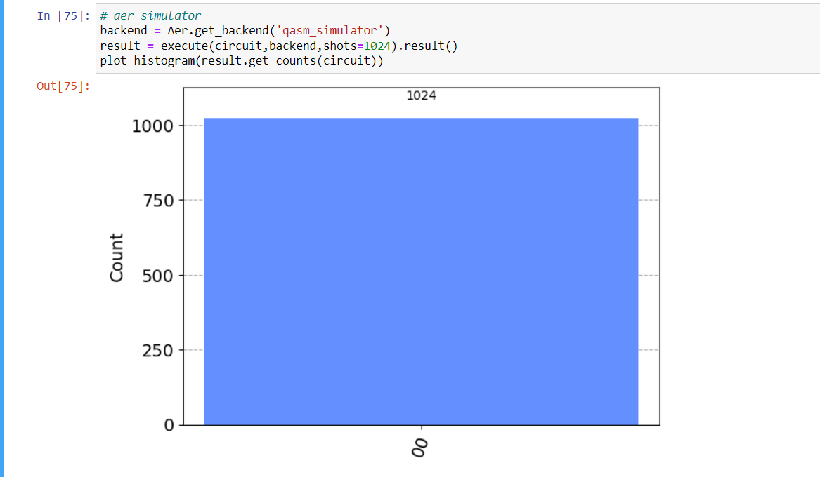
Quantum Noise
IBM Quantum Experience Local Computer

Slide 18
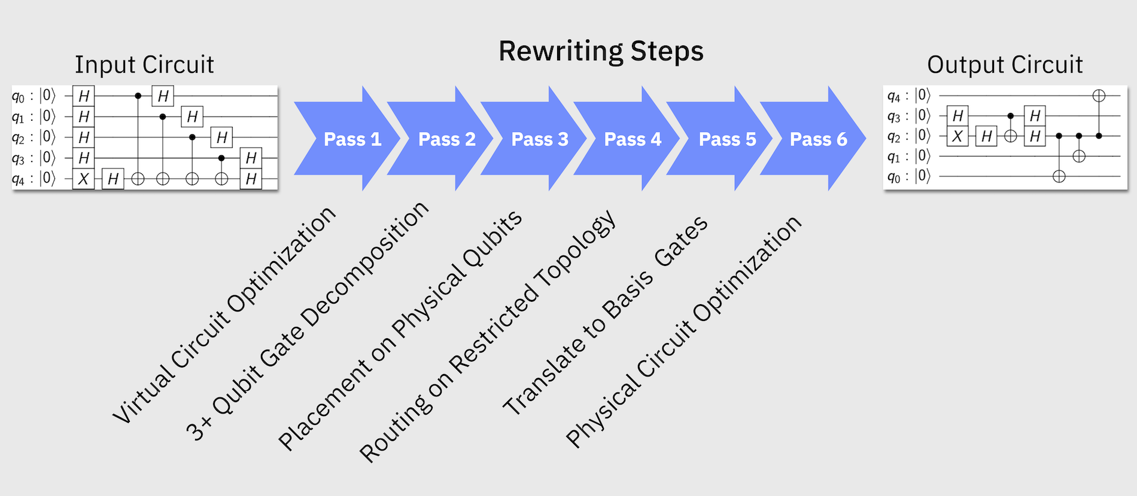
Qiskit Transpiler
Transform circuit for compatibility with target device.
Optimize to reduce the effects of noise due to transformation.
Qiskit has a in-built function for transpiling!
Source: https://qiskit.org/documentation/

Slide 19
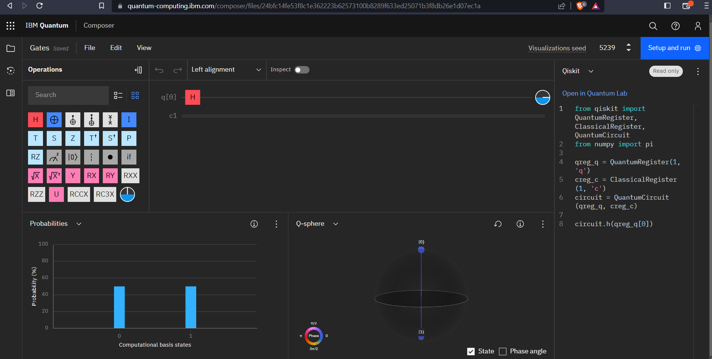
3. Using IBM Quantum Composer GUI
Source: https://quantum-computing.ibm.com/

Slide 20
Single Qubit Gates
Pauli Gates - X,Y,Z
Hadamard Gates
Phase Gates (P-gate)
Identity (I) Gate, S-Gate, T-gate
General U-gate

Slide 21
Multi-Qubit Gates
c-NOT Gate, Toffoli gate
Controlled version of other gates
cZ Gate, cH gate, cX gate and so on.
Circuits can be used a gate itself.

Slide 22

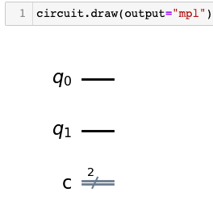
Syntax
Declaring Quantum and classical registers
Creating a circuit
Class QuantumRegister(size,name)
Class ClassicalRegister(size,name)
Class QuantumCircuit(*regs)
where *regs is a list of registers or list of int representing number of qubits and classical bits to include in the register

Slide 23
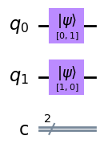
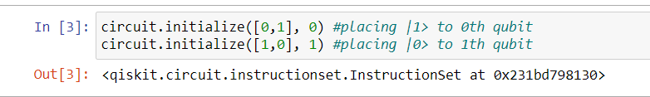
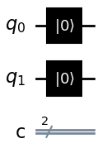

Syntax
3. Initialize qubits
a. Using initialize( ) method
b. Using reset( ) method
Fig. Using initialize
Note: By default each qubit is assigned |0>
Fig. Using reset

Slide 24
Syntax
3. Initialize qubits
a. Using initialize( ) method
b. Using reset( ) method
Fig. Using initialize
Can only initialize |0> state !
Note: By default each qubit is assigned |0>
Fig. Using reset

Slide 25
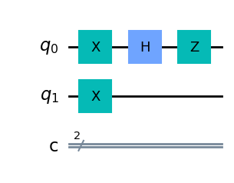
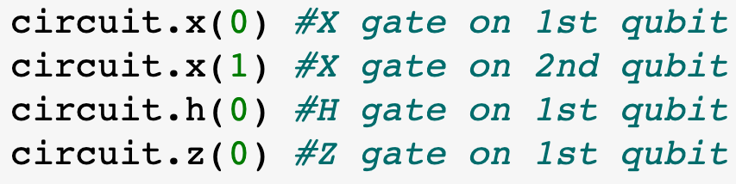
Applying Gates : Single Qubit Gates
Invoked from QuantumCircuit class.
Methods:
x() - X gate
h() - H Gate
z() - Z Gate, etc.
QuantumCircuit.<gate>(qubit=(int or list))

Slide 26
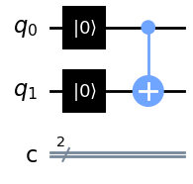
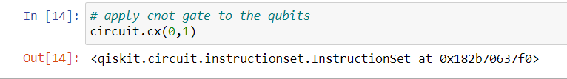
Applying Gates: Multi-Qubit Gates
Below is the snippet cNOT gate where the first qubit is control bit and the second is the target bit
First parameter is the control bit and the second is the target bit.
Important to specify which bit to set as control bit and which to set as target bit
Fig. cNOT Gate

Slide 27
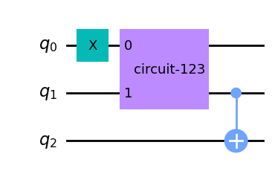
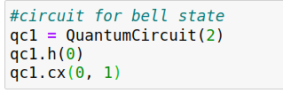
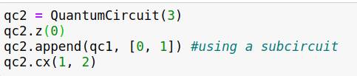
Circuit as a Gate
Quantum circuits can be used as a building blocks for larger circuits.
Qiskit allows you to use a quantum circuit as a gate in another circuit.
QuantumCircuit.append(circuit, qargs=list) method
Creating a bell state circuit
Using the above circuit as a subcircuit in the new circuit
Fig. Using qc1 as subcircuit

Slide 28
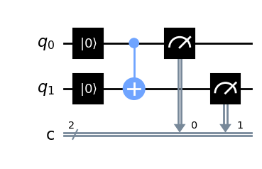
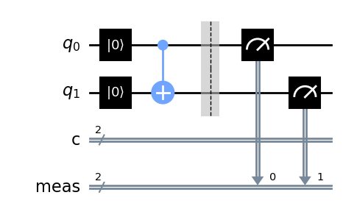
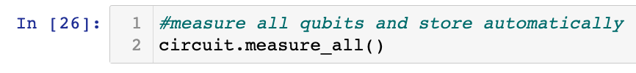
Measurement
Measuring qubits and storing in classical bits manually
Measuring qubits without specifying classical registers
QuantumCircuit.measure(qubit = (int or list), cbit= (int or list))
Fig. Using measure()
QuantumCircuit.measure_all( )
Fig. Using measure_all()

Slide 29
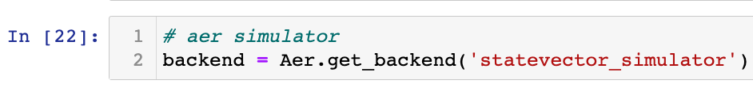
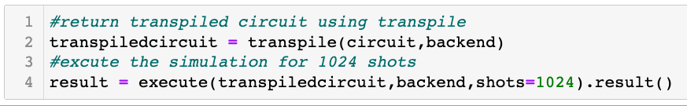
Simulation
Calling simulator
Simulation Execution
‘statevector_simulator’
‘qasm_simulator’
‘unitary_simulator’
Simulator.get_backend(method=str,device=‘CPU’)
These backends can be run on either CPU or GPU.
By default it runs on CPU.
Step 1: Transpile the circuit supported by the target backend
Step 2: Execute the simulator on transpiled circuit

Slide 30
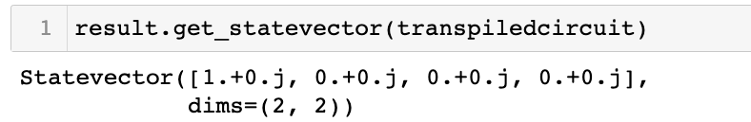
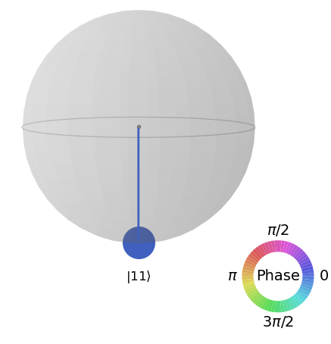
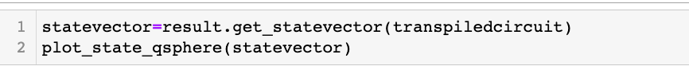
Visualization : State-vector
State Vector Representation (Matrix Representation)
Q-sphere
result.get_statevector(circuit) method
plot_state_qshpere(statevector) function
Fig. Q-sphere representing output state-vector

Slide 31
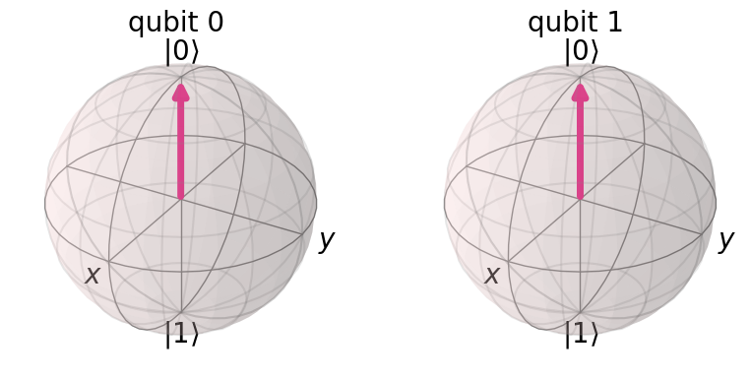
Visualization : State-vector
3. Block Sphere
plot_bloch_multivector(statevector) function

Slide 32
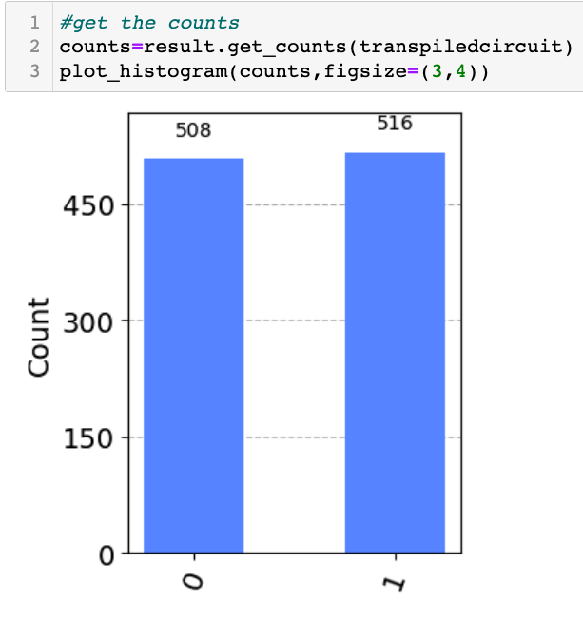
Visualization: Counts after Measurement
Histogram
result.get_counts(circuit) returns dic where keys are states and value are counts
plot_histogram() function to plot the histogram

Slide 33
Tutorial
In tutorial we will cover the following:
Implementation of each gates (X, Z, H and cNOT)
Demonstrate each simulators and their usage
Measurement
Proving X = HZH
Entanglement - Bell States
Quantum Teleportation
Implementing circuit using IBM Composure (GUI)

Slide 34
Phase 2
In Phase 2 we will implement the following:
Implement quantum algorithms
Scale up the hilbert space
Observe the effects when scaling up (Benchmarking)

Slide 35
Thank You!
Pawel Pratyush
Vrushali Shinde

